Slide 1
Discrete Structure Applications of Logic
Week 4
By
Dr. Rafiullah Khan

Slide 2
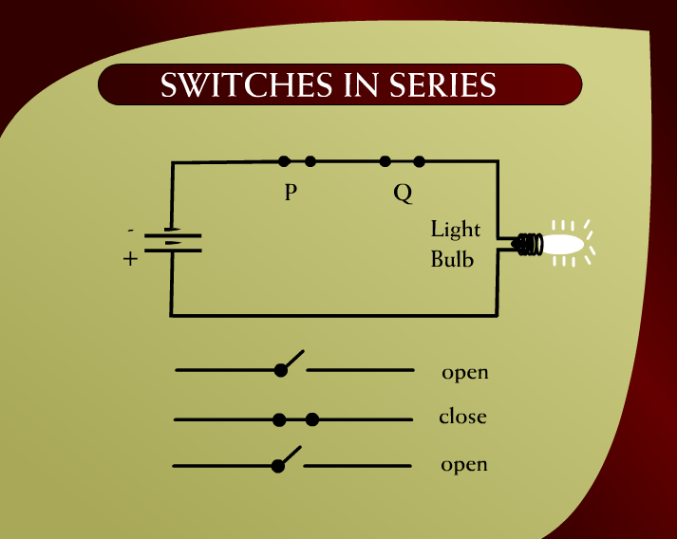
Switches in Series – (6 - 1)

Slide 3
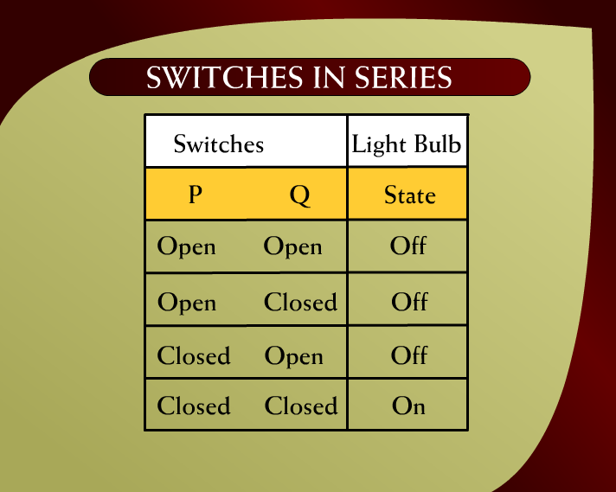
Switches in Series – (6 – 1a)

Slide 4
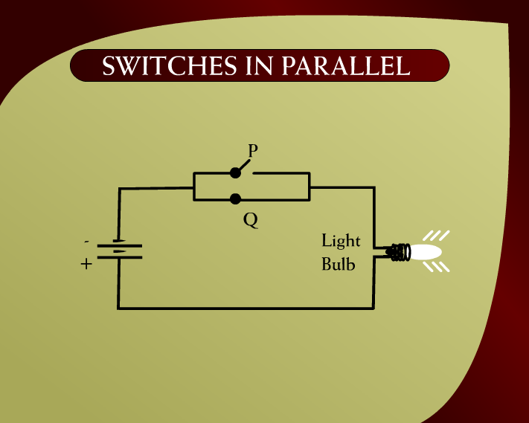
Switches in Parallel – (6 – 2)

Slide 5
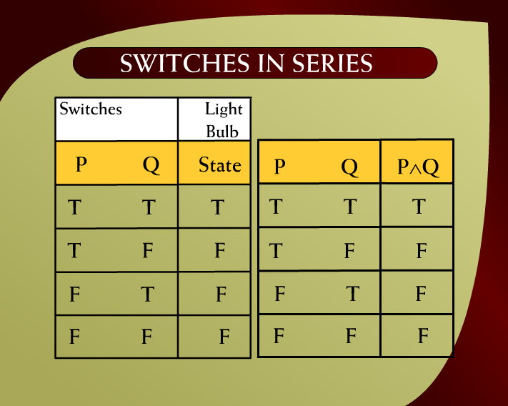
Switches in Series – (6 - 4)

Slide 6
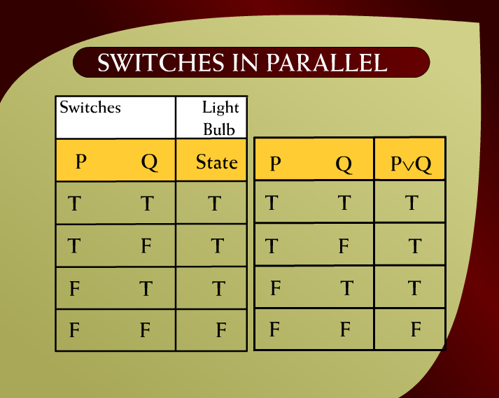
Switches in Parallel – (6 - 5a)

Slide 7
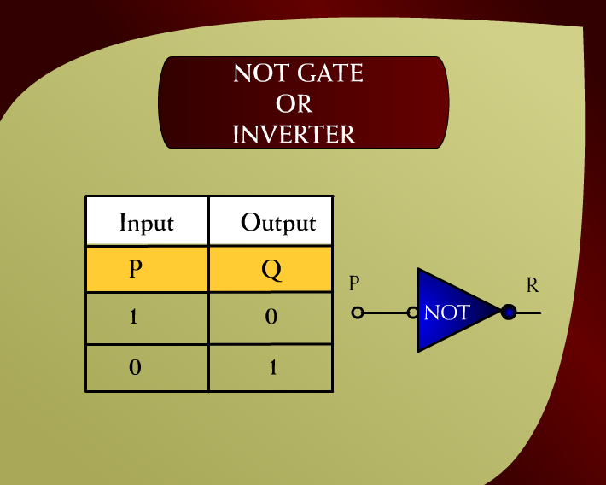
Not Gate or Inverter – (6 – 7)

Slide 8
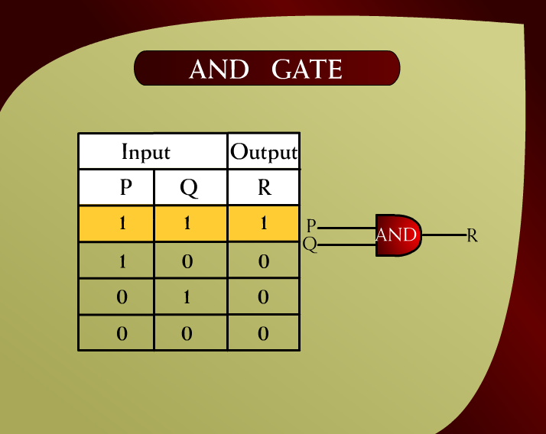
AND Gate – (6 - 8)

Slide 9
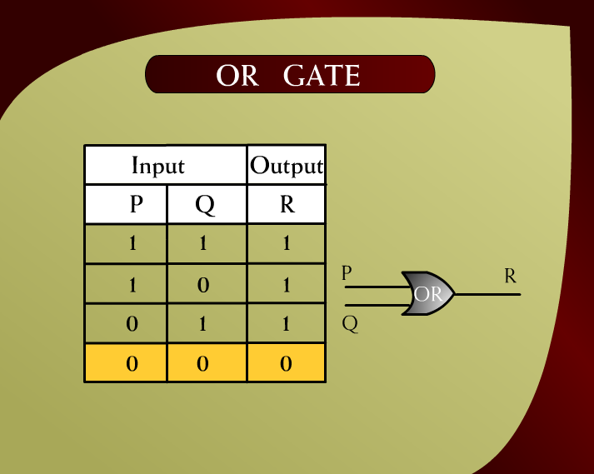
OR Gate – (6 - 9)

Slide 10
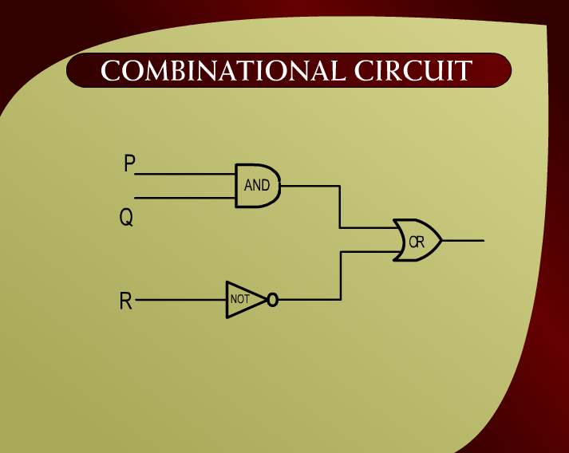
Combinational Circuit – (6 - 11)

Slide 11
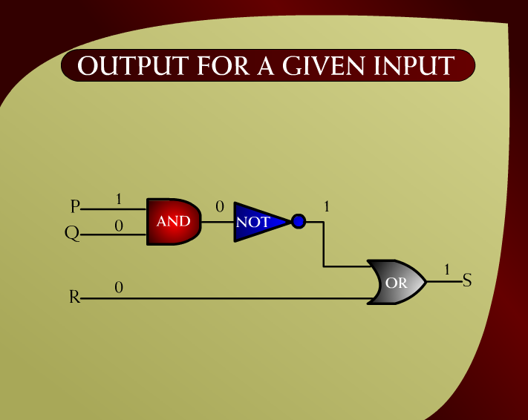
Output for a Given Input – (6 - 13)

Slide 12
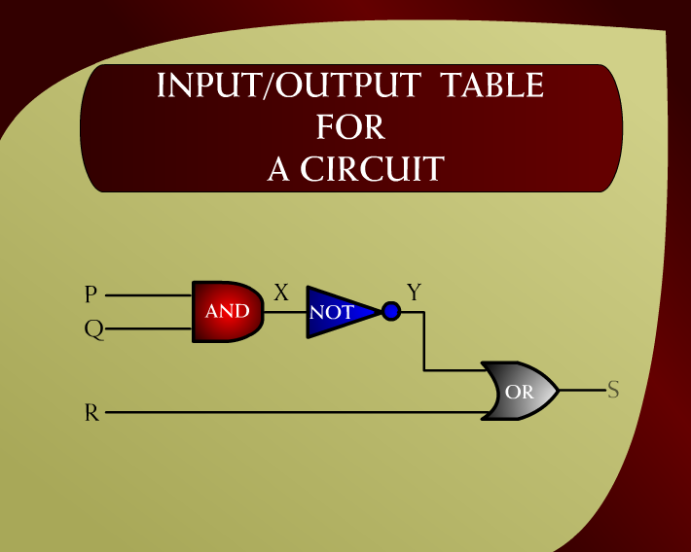
Input/Output Table for a Circuit – (6 – 14)

Slide 13
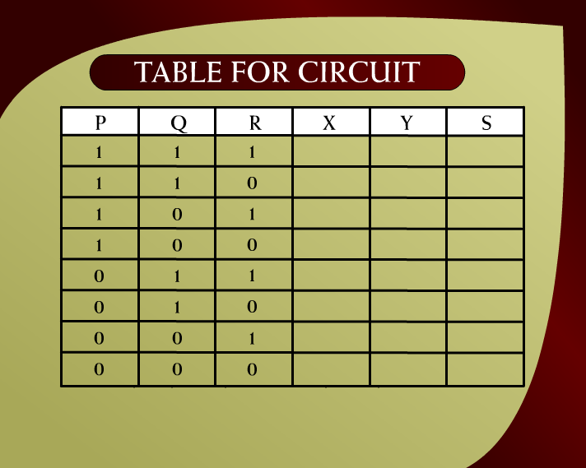
Table for Circuit – (6 – 16c)

Slide 14
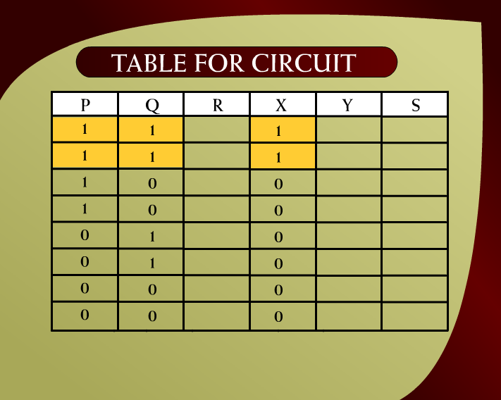
Table for Circuit – (6 – 16a)

Slide 15

Table for Circuit – (6 – 16b)

Slide 16
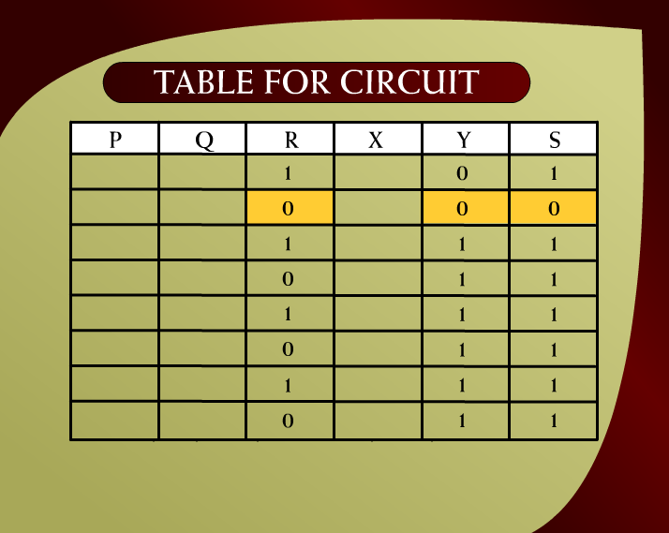
Table for Circuit – (6 – 16)

Slide 17
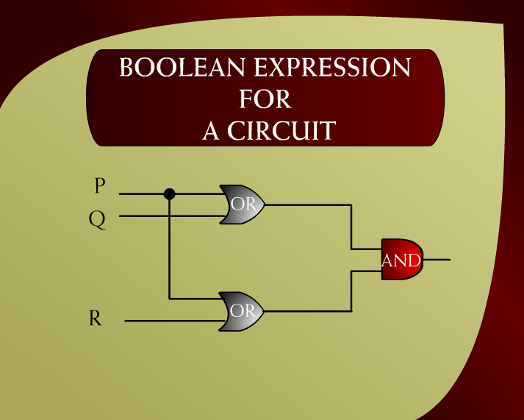
Boolean Expression for a Circuit – (6 – 18)

Slide 18
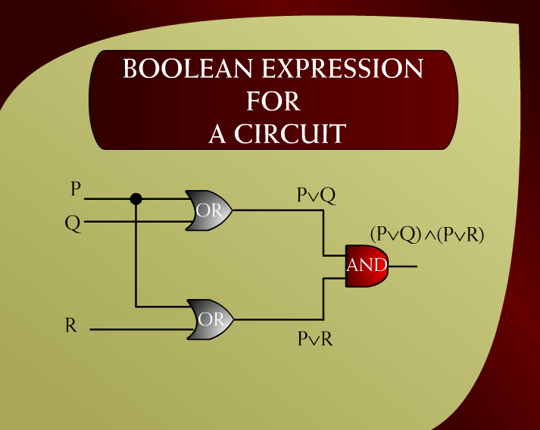
Boolean Expression for a Circuit – (6 - 19)

Slide 19
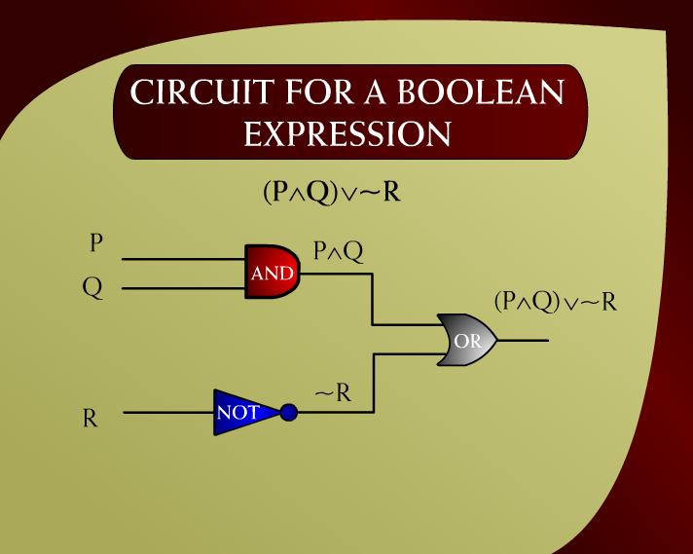
Circuit for a Boolean Expression – (6 – 20)

Slide 20
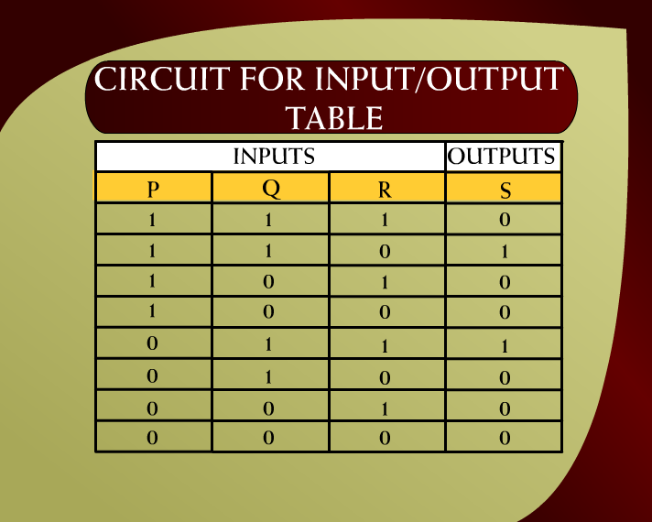
Circuit for Input/Output Table – (6 – 21)

Slide 21
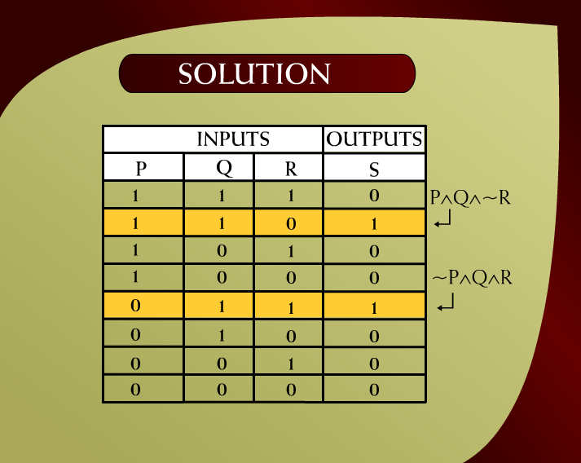
Solution – (6 - 22)

Slide 22
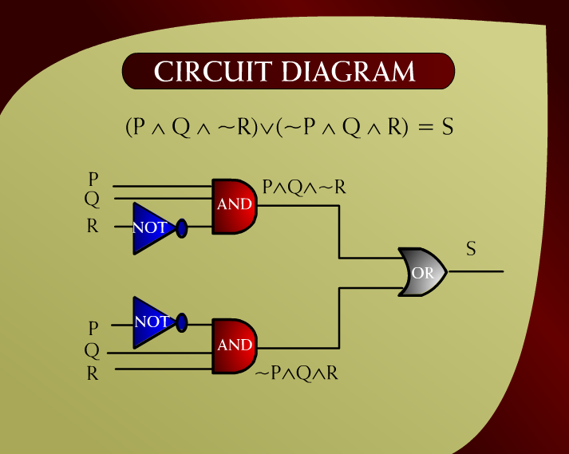
Circuit Diagram – (6 – 23)

Slide 23
Solution – (6 - 22)

Slide 24
Circuit Diagram – (6 – 23)

Slide 25
Create Circuits from the following Expressions
(P∧Q)∨(¬P∧Q)∧(P∧¬Q)
(P∨Q)∧(P∨¬R)∧(¬Q∨R)
(P∨Q)∧(¬P∨Q)∧(P∨¬Q)
(¬P∧¬Q)∨(P∧Q)∨(P∧¬Q)
(¬P∨Q)∧(P∧¬Q)∧(¬P∨¬Q)

Slide 26
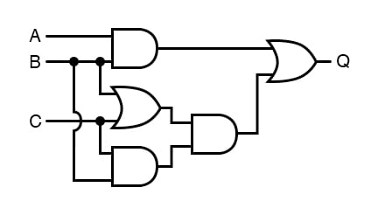
Convert the following circuit into Logical Statements (1)

Slide 27
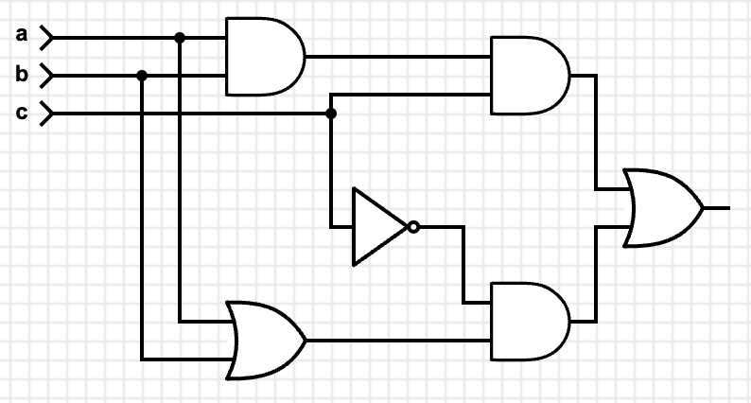
Convert the following circuit into Logical Statements (2)

Slide 28
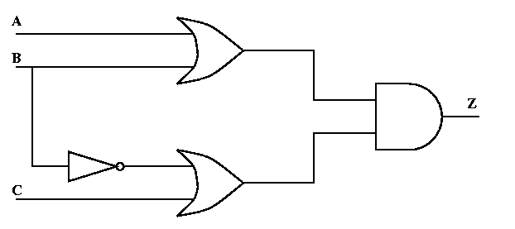
Convert the following circuit into Logical Statements (3)

Slide 29
Home Practice

Slide 30
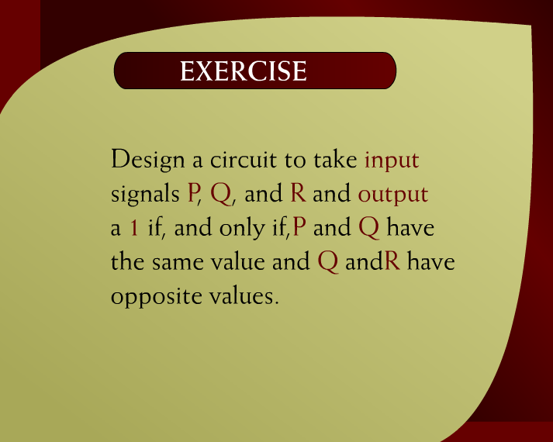
Exercise – (6 – 24b)

Slide 31
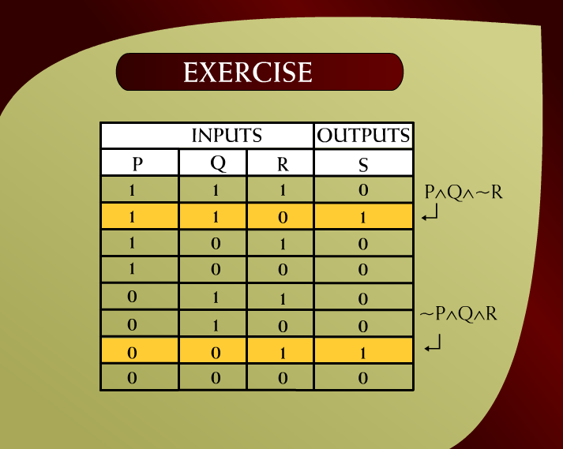
Exercise - (6 - 24)

Slide 32
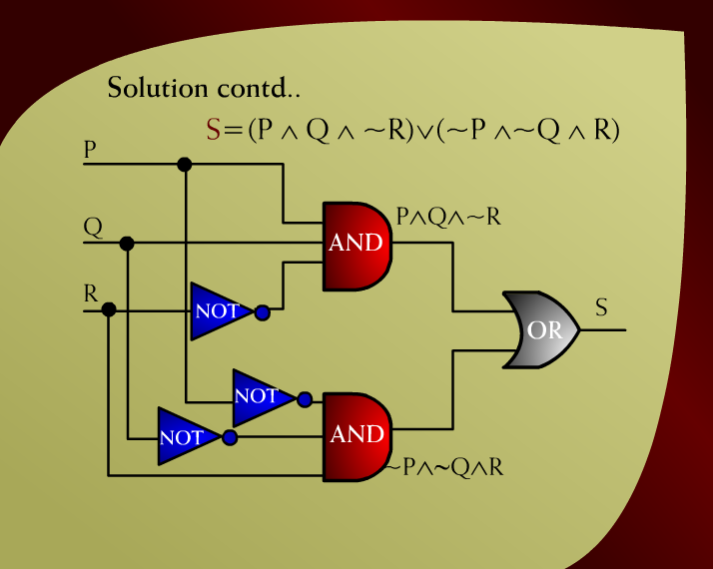
Solution – (6 - 25)

Slide 33
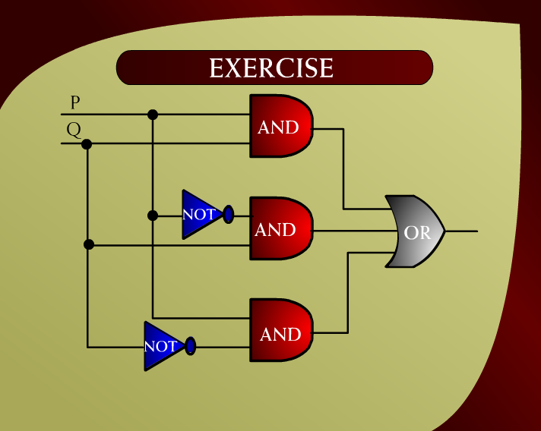
Exercise – (6 - 27)

Slide 34
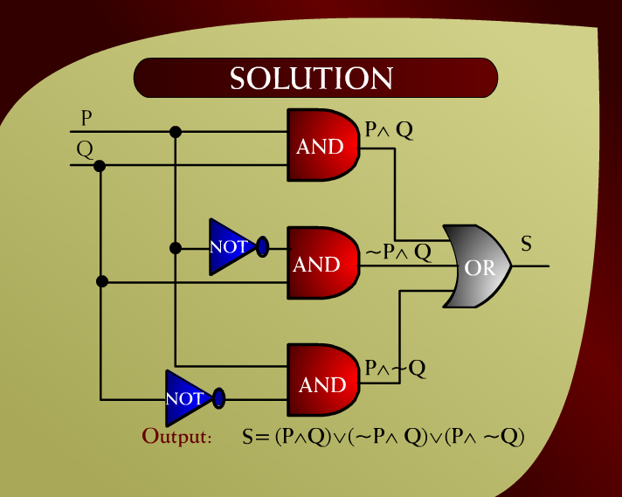
Solution – (6 - 28)

Slide 35
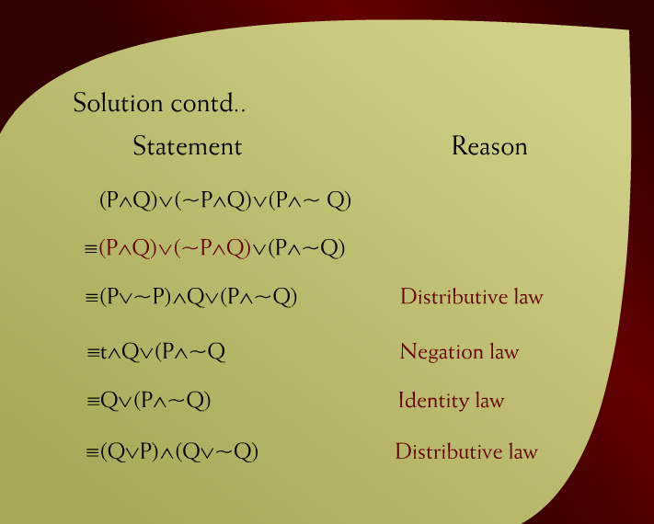
Solution – (6 - 29)

Slide 36
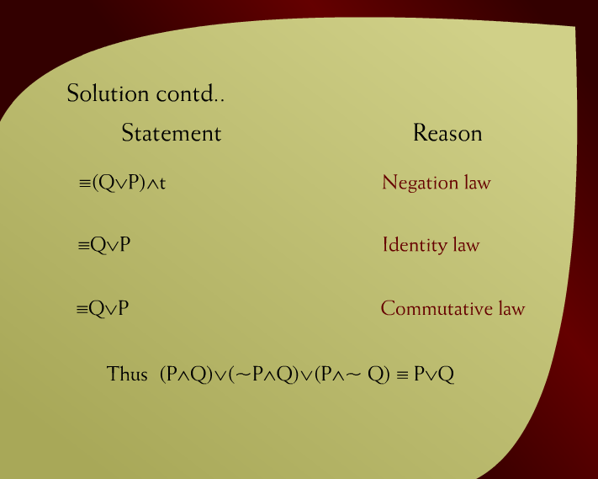
Solution – (6 – 29a)

